Slide 1
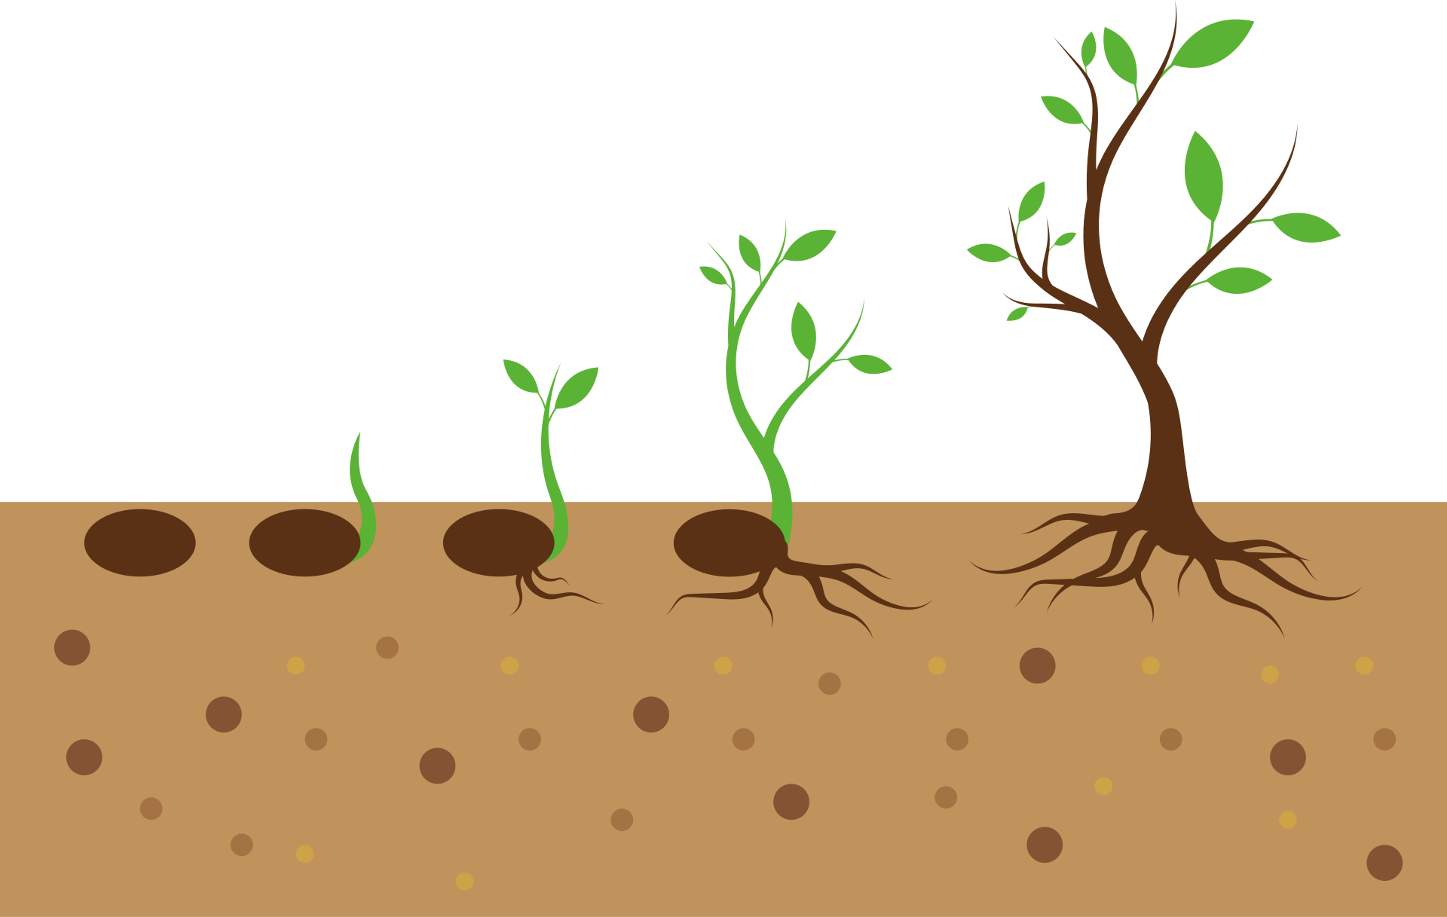
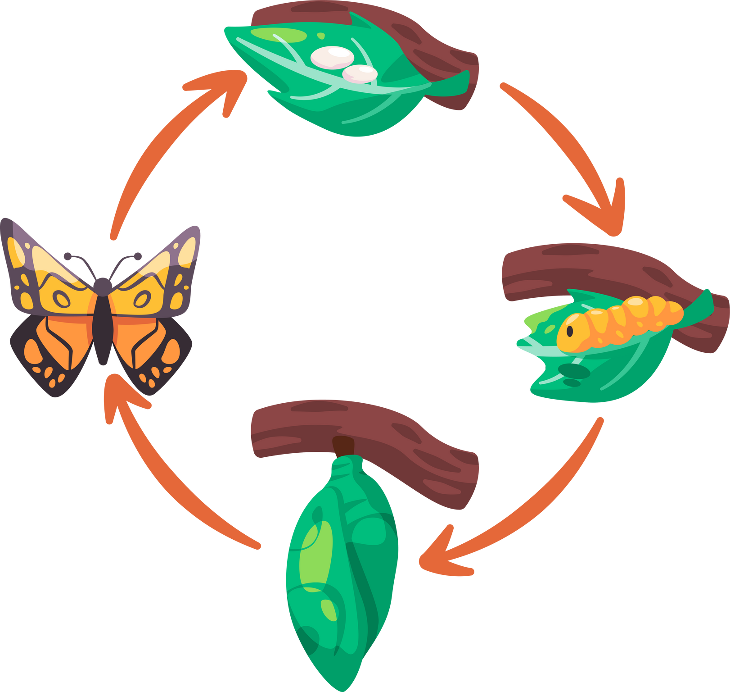
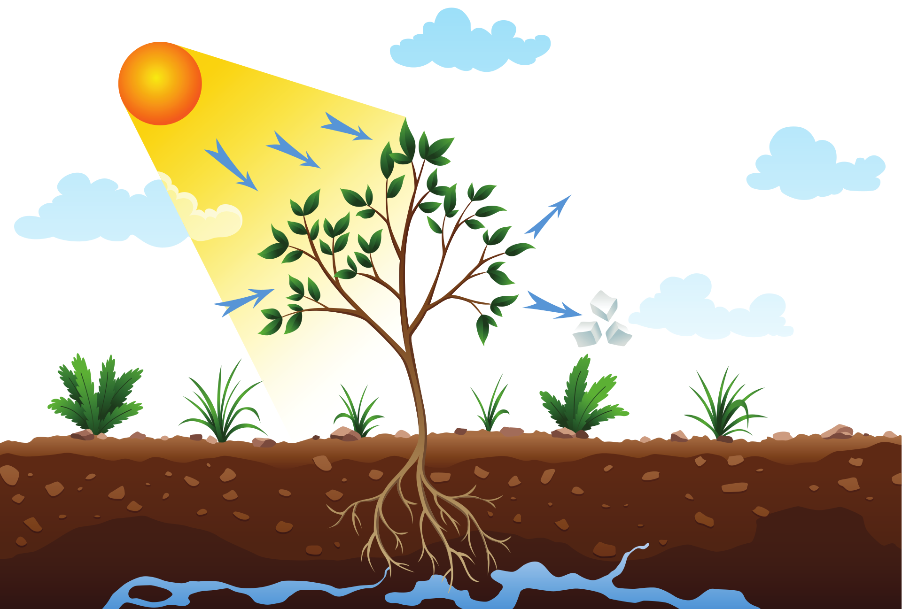
"Life Processes: The Symphony of Survival"
An Exploration of the Fundamental Processes that Sustain Life"

Slide 2
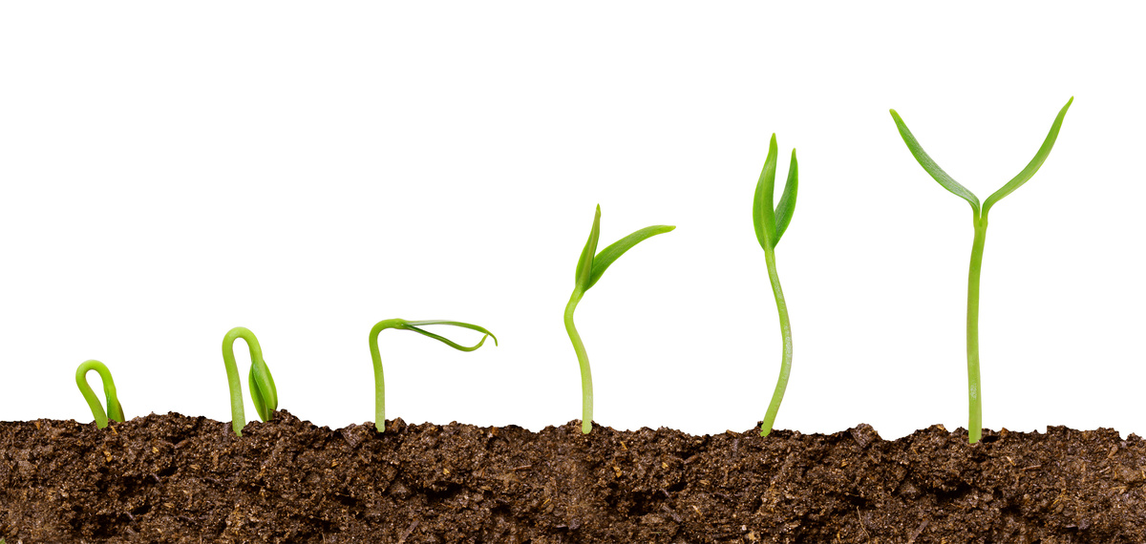
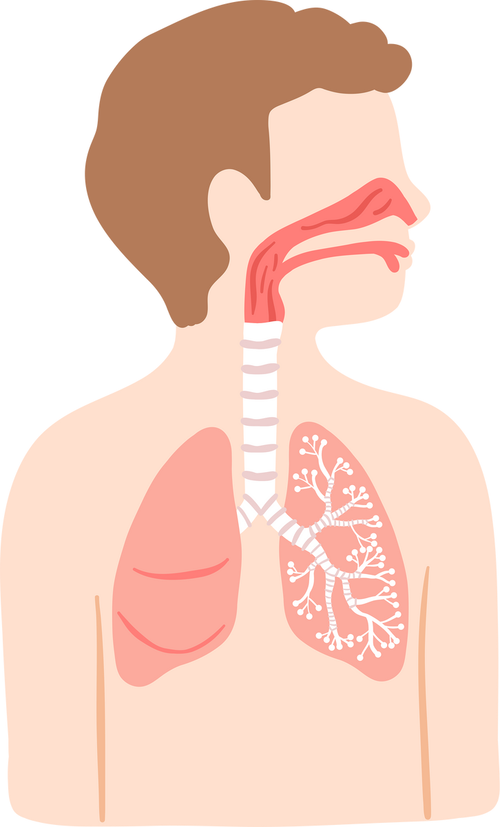
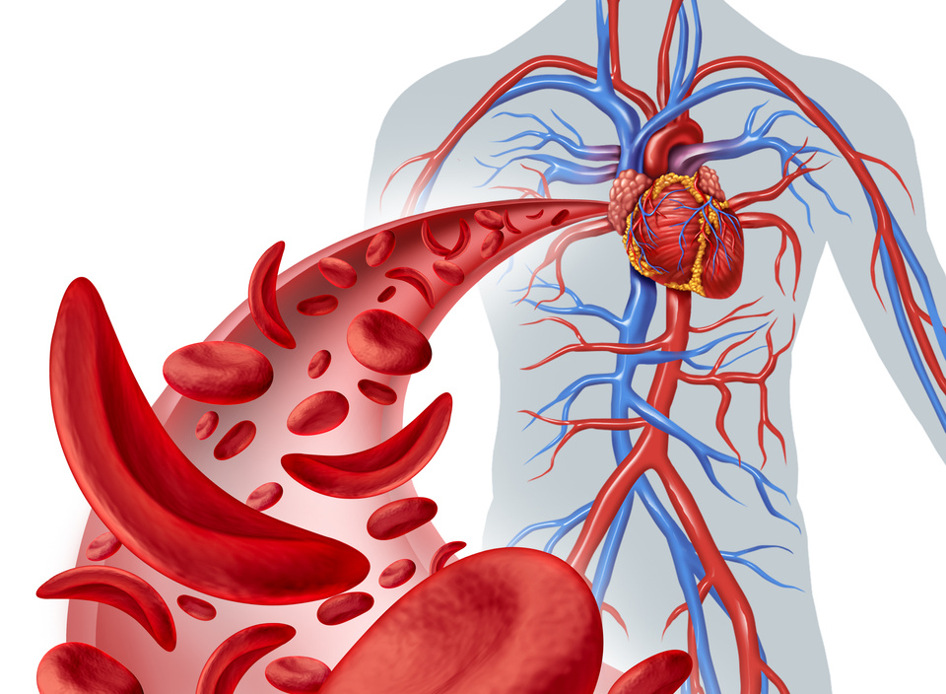
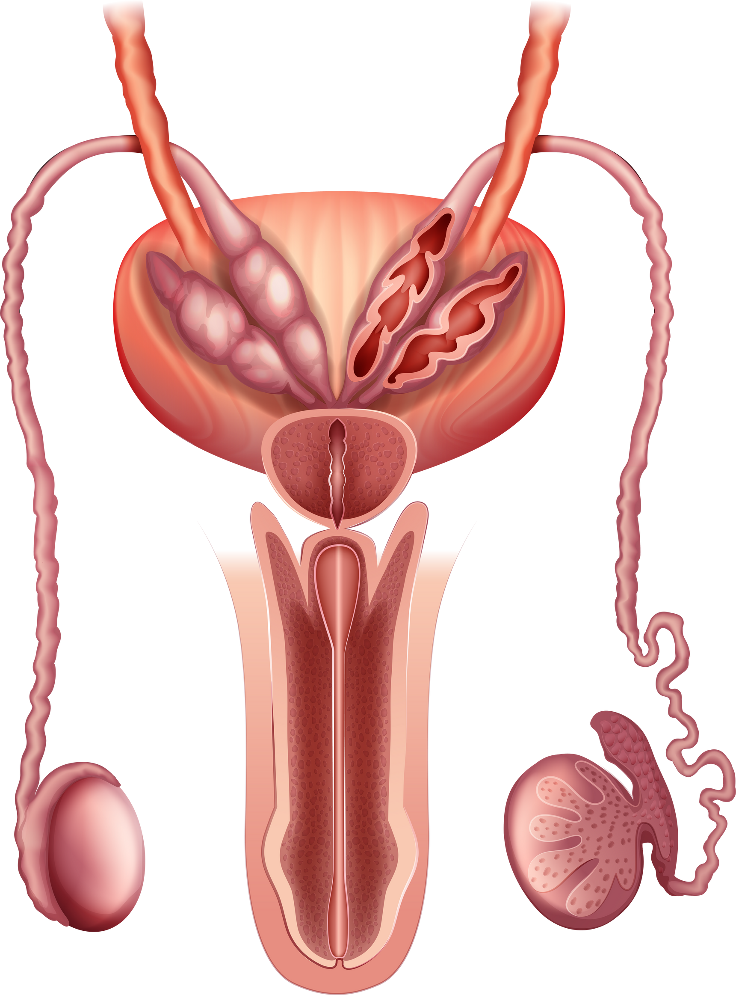
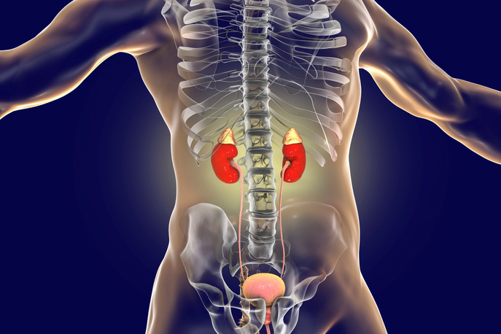
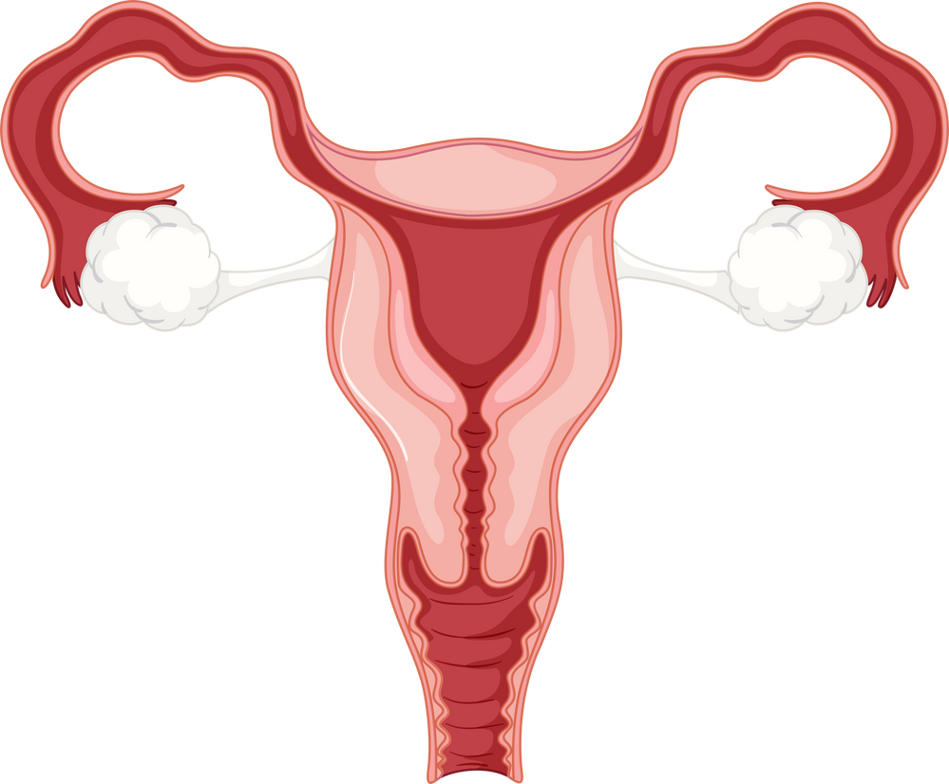

Introduction

Slide 3

Definition of Life Processes:
Life processes encompass the set of vital activities that living organisms perform to maintain their existence, grow, reproduce, and respond to their environment. These processes are essential for the survival and functioning of an organism.

Slide 4

Importance in Sustaining Life:
Life processes are the foundation of an organism's survival and overall well-being. They play a crucial role in maintaining the balance and harmony necessary for life to thrive
Each life process, from nutrition and respiration to excretion and reproduction, contributes to the overall sustainability of living organisms. Without these processes, life as we know it would be unsustainable, and the intricate web of interactions within ecosystems would cease to function.

Slide 5

Interesting Fact:
Did you know that the average human body produces enough saliva in a lifetime to fill two swimming pools? Saliva production is part of the digestive process, highlighting the fascinating and continuous nature of life processes that happen within our bodies every day.

Slide 6

Overview of Life Processes
List of fundamental life processes:
  Nutrition
  Respiration
  Transportation
  Excretion
  Reproduction

Slide 7

Nutrition
  Ingestion
  Digestion
  Absorption

Slide 8

Definition:
Types:
Ingestion is the process of taking in food or nutrients into the body. It is a crucial step in the life process of nutrition, where organisms acquire the necessary substances for energy, growth, and maintenance of bodily functions.
Autotrophic
Heterotrophic:
Autotrophic organisms are those capable of producing their own food through processes like photosynthesis
Heterotrophic ingestion involves the intake of preformed organic substances, like complex molecules and compounds, which the organism cannot produce independently.

Slide 9

Digestion
Types
Digestion is the process by which complex food substances are broken down into simpler, soluble forms that can be absorbed and assimilated by the body.
Intracellular
Extracellular
Organs involved in digestion
Mouth , stomach , pancreas, liver, small intestine , large intestine.

Slide 10
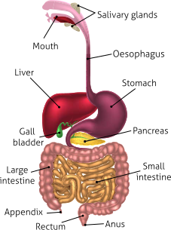

Slide 11

Respiration:
Respiration is a complex biological process that involves the exchange of gases, primarily oxygen and carbon dioxide, between an organism and its environment. It is a fundamental life process essential for the production of energy required for various cellular activities.

Slide 12


Types
There are two main types of respiration: external respiration, which occurs between an organism and its surroundings, and internal or cellular respiration, which takes place within the cells.

Slide 13
Breathing
Difference between respiration and breathing
Breathing, also known as ventilation, is the mechanical process of moving air in and out of the lungs. It involves the inhalation of oxygen-rich air and the exhalation of carbon dioxide, which is a waste product of cellular respiration.
Breathing is External; Respiration is Internal:
  Breathing: It is the external process of moving air in and out of the lungs.
  Respiration: It is the internal process occurring within cells, involving the breakdown of nutrients to release energy.

Slide 14
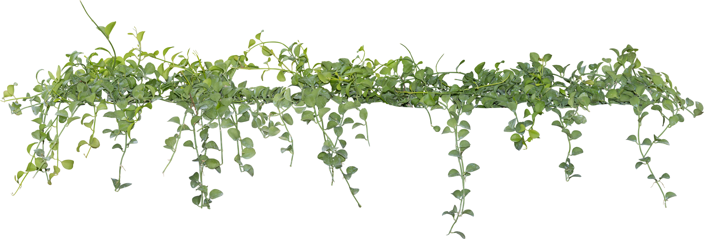
Cellular Respiration
Cellular respiration is a complex series of metabolic processes that take place within the cells of living organisms, converting biochemical energy stored in organic molecules into adenosine triphosphate (ATP). ATP is the primary energy currency used by cells for various cellular activities.

Slide 15

ATP
ATP is crucial for cellular activities as:
  Energy Currency: It serves as the primary energy currency of cells.
  Cellular Work: Powers mechanical, transport, and chemical work in cells.
  Metabolic Reactions: Drives essential metabolic pathways.
  Synthesis of Macromolecules: Provides energy for the synthesis of complex molecules.
  Cellular Communication: Participates in cell signaling and phosphorylation.
  Active Transport: Powers active transport processes across cell membranes.
  Maintenance of Membrane Potential: Contributes to maintaining electrochemical gradients.
  Storage and Transfer of Energy: Acts as an intermediary in energy transfer.
  Quick Energy Source: Releases energy rapidly for immediate cellular needs.
In essence, ATP is indispensable for sustaining life and enabling various cellular functions.

Slide 16
Transportation
Types
Transportation refers to the movement of substances, such as nutrients, gases, and waste products, within the bodies of living organisms. This process is essential for the distribution of materials needed for cellular activities and the removal of waste products generated by metabolic processes.
  Human circulatory system
  Plants: Xylem and Phloem
  Diffusion and osmosis
  Active Transport
  Lymphatic sysytem in animals

Slide 17
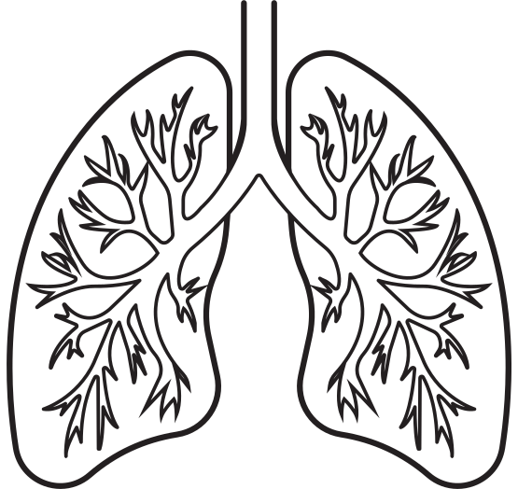

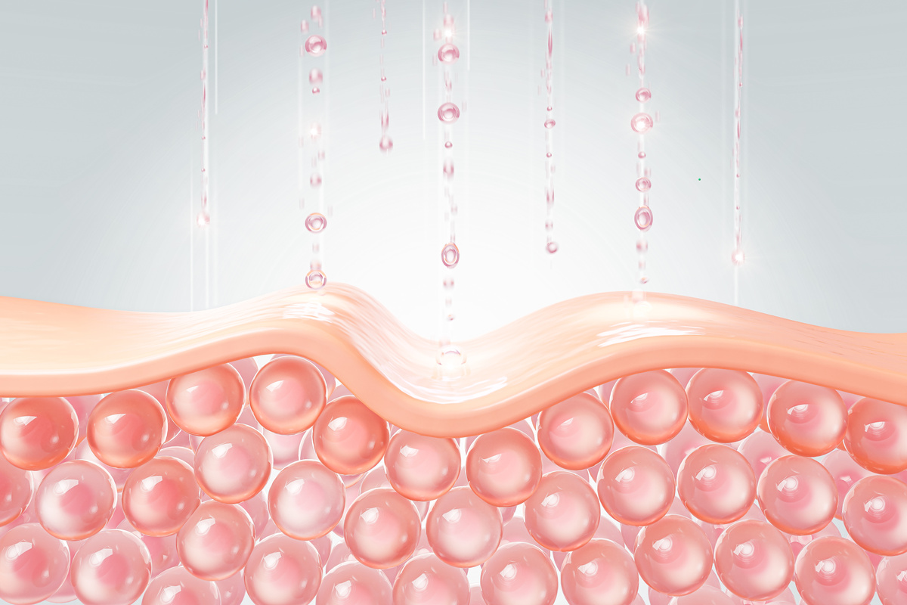
Excretion
Definition
Excretion is the process by which metabolic waste products and harmful substances are eliminated from the body, maintaining internal balance and preventing the accumulation of toxins.
Organs involved
  Kidneys,
  Lungs,
  Liver,
  Skin,
  Large intestine

Slide 18
Reproduction
Reproduction is the biological process by which new individuals of the same species are produced, ensuring the continuation of the species over generations. It is a fundamental characteristic of living organisms and involves the transmission of genetic material from parent organisms to their offspring.

Slide 19

Types
Asexual reproduction
Sexual reproduction
Asexual reproduction involves the generation of offspring from a single parent without the fusion of gametes. The offspring are genetically identical or nearly identical to the parent.
Sexual reproduction involves the formation of specialized reproductive cells called gametes (sperm and egg) and the fusion of these gametes to produce offspring with genetic variation.

Slide 20


